Slide 1
A Multi-faceted Program causes Lasting Progress for the Very Poor: Evidence from 6 countries
By
Robert Darko Osei
Institute of Statistical Social and Economic Research
July, 2018

Slide 2
Outline
Introduction
The Programme
The Targeting
Components
Results
Concluding remarks

Slide 3
Introduction
Having over 25% of the World population being poor is not acceptable
For the sustainability of poverty reduction piecemeal programs may not ideal
There is increasing shift to livelihoods approach
giving the poor access to self-employment activities
A key question therefore is indeed how to to get the poor to shift from their current position (of insecure and fragile income sources) to more sustainable income-generating activities.

Slide 4
A classical poverty trap
Demand for Food
Nutritional Status
Productivity and Wages
Poverty

Slide 5
Introduction - contd
There are two key dimensions of this study
First, is to ask the essential question about whether the livelihoods approach work.
Second, can the results be replicated across a diverse set of countries across the World
The study is therefore based on an RCT of the BRAC model in 6 countries – Ghana, Ethiopia, Honduras, India, Pakistan and Peru

Slide 6
Targeting
The programme is meant for the poorest of the poor
So targeting is multi-stage
Using national HH survey data you select a poor region
Select a list villages (programme sites) within this poor region
Within the programme we select ultra poor households using participatory wealth ranking (PWR)
Villagers create a ranking of all HH in the village
Field officers visit the selected HHs and use a PPI scorecard to double check their poverty status
Overall 48% of the selected HH had the per capita consumption below USD1.25 compared to 19% for the entire population

Slide 7
The Programme
The Livelihoods programme that we test involved six (6) different activities designed to complement each other to help households start, and continue with, a self-employment activity.
A one-time Productive asset transfer
Regular consumption support
Technical skills training on managing the particular productive assets
High-frequency home visits
Savings: access to a savings account and in some instances a deposit collection service and/or mandatory savings
Some health education, basic health services, and/or life-skills training

Slide 8
Programme_Productive Asset
HH chose one asset from an asset bundle
Common choices included
sheep, goats, chicken, cattle, etc. and petty trade
The value of assets ranged from– between 4 to 8 goats in local prices
Transfers took about 1-15 months across all sites

Slide 9
Programme – Consumption Support
This was to smoothen consumption and help prevent the selling of assets
It was a cash stipend distributed weekly
It lasted between 4 and 13 months across the sites
For Ghana about 1.9 to 2.9 USD per week whilst Honduras it was about 108USD over 6 months
For Honduras, it was one time and covered lean season
In Ethiopia and Peru, some form of consumption support existed and so it covered both treatment and control

Slide 10
Programme – Training & Home Visits
Training was
Before receiving assets; &
On managing their livelihoods (running a business)
Visits
To provide regular coaching
Health education
Financial management coaching
Provide encouragement

Slide 11
Programme – Savings and Health
Savings are important so households can better withstand shock.
So savings was encouraged and required in all cases
Ethiopia, Honduras, Peru and India provided access by linking to MFIs
Pakistan they were encouraged to save through savings groups
Ghana they got savings accounts (passbooks with agents collecting savings during meetings)
Health
This was essentially training in health, hygiene and nutrition.

Slide 12
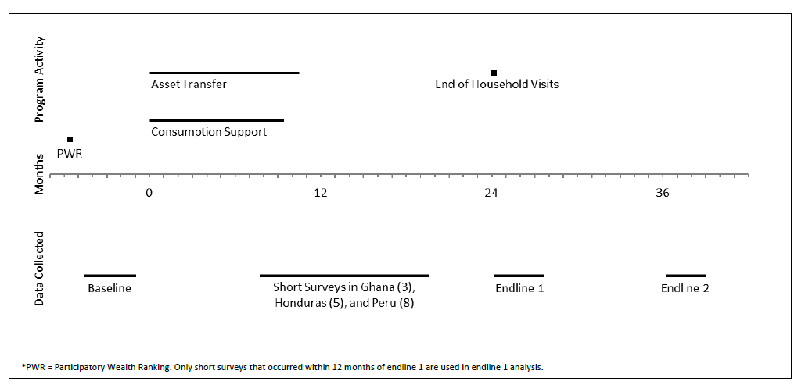
Cross-Site Timeline
No programme activity

Slide 13
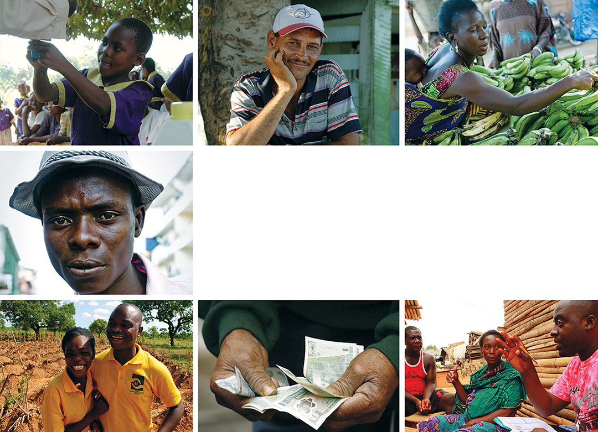
Graduating the Ultra Poor: Results

Slide 14
Per Capita Consumption
Positive impact overall with food consumption dominating
Impact persist one year after programme
Per capita consumption, month
Pooled endline 1: $4.55 (control mean $78.80)
Pooled endline 2: $3.36 (control mean $68.80)
Notes:
Total consumption per capita, monthly (2014 US$ PPP)
Pooled EL 1 – control: $78.80; treatment: $83.35 (6% increase ***)
Pooled EL 2 – control: $77.00; treatment $80.77 (5% increase ***)

Slide 15
Food Security
Positive impact here also and consistent with the increase in HH food consumption
Everyone gets enough to eat each day
Pooled endline 1: treatment 47%, control 42%
Pooled endline 2: treatment 45%, control 40%
Notes:
Everyone in household gets enough food to eat every day (0/1)
Pooled EL 1 –control 42%; treatment 47% (5 percentage point increase)
Pooled EL 2 – control 40%; treatment 45% (5 percentage point increase)

Slide 16
Asset Index
Positive impact overall on assets
Productive assets dominates overall HH assets
Asset Index
Total asset value
Pooled endline 1: $599 (control mean $2619)
Pooled endline 2: $533 (control mean $2300)
Notes:
Total asset value (drawn from data from Peru, Pakistan, Honduras, Ethiopia – effect size is from whole sample’s asset index)
(2014 US$ PPP)
Pooled EL 1 – control 2619; treatment 3218 (23% increase)
Pooled EL 2 – control 2726; treatment 3018 (11% increase)

Slide 17
Time Use
Time Use
Time Use
Adult labour increases
Increase concentrated on livestock and agriculture activities
Minutes spent on productive activities
Pooled endline 1: 17.5 (control mean 169)
Pooled endline 2: 11.2 (control mean 185)
Notes:
Total number of minutes spent on productive activity, last 24 hours
Pooled EL 1 – control: 169; treatment 186.5 (10.4% increase ***)
Pooled EL 2 – control: 185; treatment: 196.2 (6.1% increase ***)

Slide 18
Financial Inclusion
Positive impact on savings
Year II impact not too surprising but persistence is very positive
Total savings balance
Pooled endline 1: $159.41 (control mean $97.07)
Pooled endline 2: $58.38 (control mean $78.38)
Notes:
Total savings balance (2014 US$ PPP)
Pooled EL 1 – control 97.07; treatment 256.48 (164% increase)
Pooled EL 2 – control 92.60; treatment 171.00 (85% increase)

Slide 19
Physical Health
Generally limited impact Activities of Daily living score.
Also limited to endline 1
Activities of daily living index
Pooled endline 1: treatment 83%, control 82%
Pooled endline 2: treatment 81%, control 80%
Notes:
Activities of daily living score (index of ease with which person can complete activity: lifting something heavy, walking certain distance, working all day)
Pooled EL 1 – control 82%; treatment 83% (1 percentage point increase)
Pooled EL 2 – control 80%; treatment 81% (1 percentage point increase)

Slide 20
Political Involvement
Programme was good for social inclusion
Member has attended village meeting, last year
Pooled endline 1: treatment 45%, control 42%
Pooled endline 2: treatment 39%, control 36%
Notes:
Member has attended village meeting (0/1)
Pooled EL 1 –control 42%; treatment 45% (3 percentage point increase)
Pooled EL 2 – control 36%; treatment 39% (3 percentage point increase)

Slide 21
Quantile results: Consumption
Consumption benefits are not for those who are relatively better off
Persistence seem higher for highest quantile
Notes:
Endline 1:
10th: 0.065***
25th: 0.067***
50th: 0.045**
75th: 0.099***
90th: 0.140**
Endline 2:
10th: 0.053***
25th: 0.061***
50th: 0.079***
75th: 0.105***
90th: 0.206***

Slide 22
Cost Effective?
Generally the benefits out weight the costs.
But the rate of returns are not great
Costs are quite high for scaling up
23.4%
13.3%
9.5%
7.5%
6.9%
n.a
2900
3466
2660
1192
3812
4609
Notes:
Total Benefits = Year 1 non-durable consumption ITT (assuming equal to Year 2) + Year 2 non-durable consumption ITT + Year 3 household asset ITT + year 3 non-durable consumption ITT + Year 4 onward total consumption ITT, assuming year 3 gains in perpetuity
Total Costs = Total costs, inflated to year 3 at 5% annual discount rate

Slide 23
Concluding Remarks

Slide 24
Summary
We find positive impacts across board
A big push (a more holistic effort even over limited time) led to positive poverty outcomes
The programme may have unlocked the poverty trap
Seen from the largely durable programme impact
But the average impact is not large
So it is possible these households move to join the bigger pool of ‘poor households’
Or it is those closer to edge of the poverty trap exiting whilst the rest fall back into it (heterogeneous impacts)
Importantly, cash transfers alone may not be adequate to move households out of poverty.
Need to unpack impacts and make them ‘scalable’

Slide 25
THANK YOU

