Slide 1
The AMA Innovation Lab Approach to Resilience
Tara Chiu, Assistant Director
Feed the Future Innovation Lab
for Assets and Market Access
25 July 2018

Slide 2
Ama innovation lab
Building knowledge that helps empower smallholder farmers in the developing world to create a secure, self-reliant and prosperous future for their families and communities.
The Feed the Future Innovation Lab for Assets and Market Access at UC Davis (AMA Innovation Lab) conducts and supports research on policies and programs designed to help smallholder farmers to manage risk, adopt productive technologies and take an active part in economic growth.

Slide 3
Generating evidence
Three ways of generating and testing new knowledge:
Foundational and theoretical research to build out guiding concepts on poverty, food security and resilience.
Evaluations of technical innovations, programs and policies using the most advanced research methods, including RCTs.
Innovating, testing and refining solutions, from pilot to scale, that can help rural households to manage risk and to take productive agricultural technologies from the shelf to the field.
Through this approach, we can develop and test innovative programs and interventions on the ground to measure what can have the biggest impacts.

Slide 4
Dynamics of poverty and resilience
A defining feature of our work is a focus on the dynamics of poverty and resilience, specifically how households move up and down through different states of well-being.
  poor
  vulnerable
  non-poor
Trajectories through these states depend on
Assets: land, buildings, livestock, machinery, liquid assets and other forms of physical capital
Human capability: skill, human capital and self-efficacy.
Income shock: drought or other weather-related shock, injury or illness, macroeconomic failure
Interventions targeting poor and ultra-poor move households out of poverty but does not stop people from falling into poverty. We need to invest in both to sustainably shrink poverty and promote broad-based resilience.

Slide 5
Strategies to promote resilience
Just as a single definition of poverty is not all-encompassing, neither are approaches to promoting well-being and resilience.
The benefits of development strategies that focus on both parts of promoting resilience stretch from the households who struggle most all the way to the communities, local economies and nations in which they live.
Strategies that promote and support resilience at each of these levels show a clear pathway toward long-term self-reliance in spite of periodic shocks and an end to the need for development aid.

Slide 6

Today’s innovationS in promoting sustainable resilience
Today’s conference will discuss emerging evidence on graduation programs from around the region and stimulate discussions on how best to use this evidence to design interventions for significant and sustainable impacts.

Slide 7
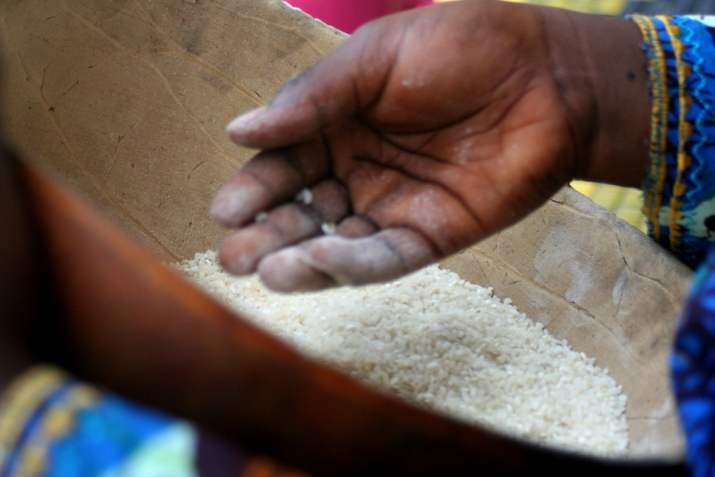
Thank you

