Slide 1
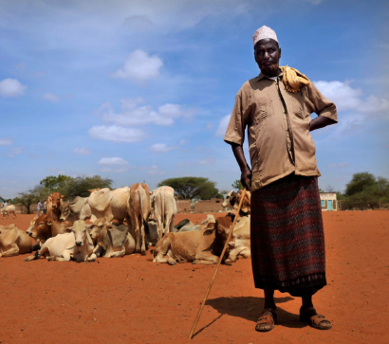
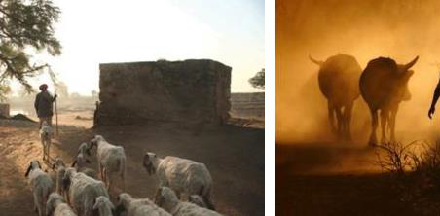
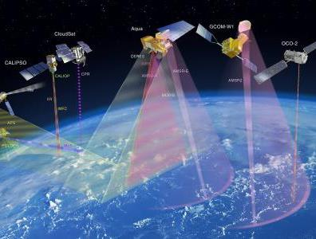


IBLI: Sustainable Risk Management for Pastoralist
Evidence of Impacts: N.Kenya and S.Ethiopia
Andrew Mude, IBLI Program Lead,
International Livestock Research Institute
Evidence To Action: Building Resilience Through Graduation Programs
July 23rd, Nairobi

Slide 2
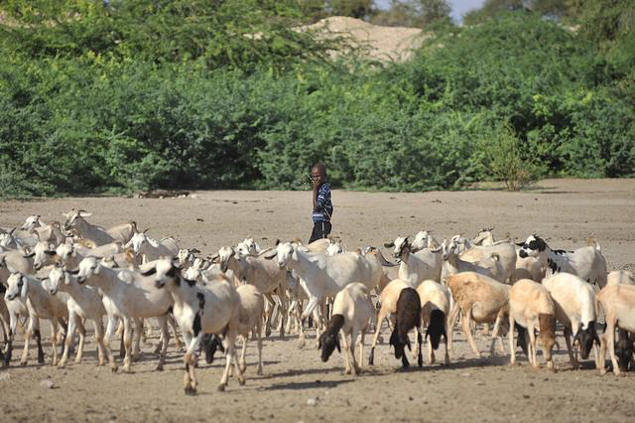
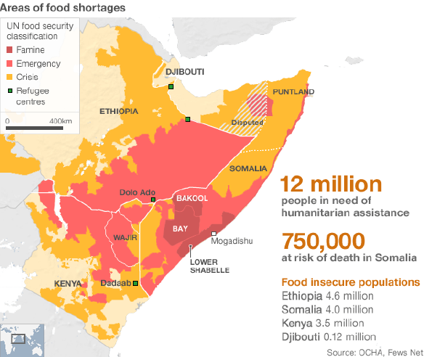
Why Livestock Insurance in the Arid Lands
LIVESTOCK AND LIVELIHOODS
In East Africa and the Sahel pastoralism is the principal livelihood for over 40 million people;
In the Horn of Africa, exports of livestock and livestock products exceed $1billion annually.
In the region, estimated contribution of the livestock economy represents up to 60 percent of agricultural GDP
THE CENTRALITY OF LIVESTOCK
In northern Kenya and Southern Ethiopia:
Median pastoralist household holds 100% of their productive assets in livestock
Livestock products and sales of livestock are 40% of income for average household
2011

Slide 3
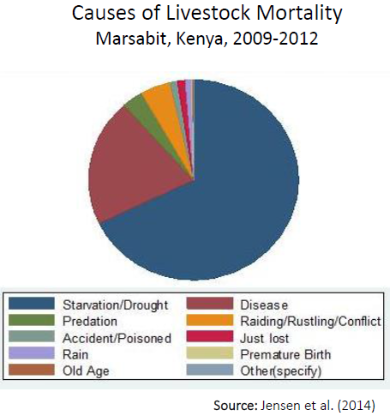
Why Livestock Insurance in the Arid Lands
VULNERABILITY TO LIVESTOCK LOSSES
Strong evidence of the asset-based poverty traps putting a premium of productive safety nets
Over 70% of livestock losses, among pastoralists, due to drought.
The “social protection paradox” becomes a concern. Where poverty trap exists, social protection resources can easily be exhausted, as the poor remain stuck and the non-poor fall in due to shocks. (Ikegami, Barrett, Carter and Janzen. 2018)
Development impacts of risk reduction technologies (insurance) should therefore be significant.
Source: Lybbert et al. (2004 EJ) on Boran pastoralists in s.Ethiopia.

Slide 4
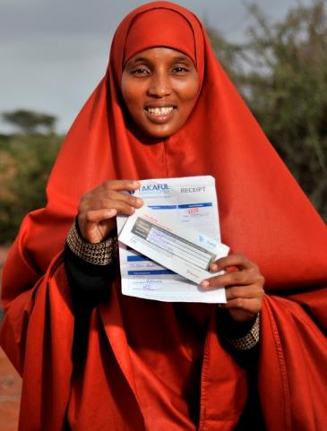
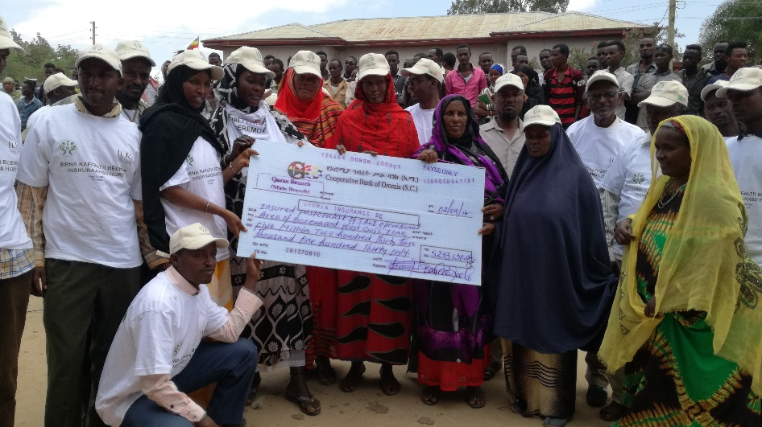
What is Index-Based Insurance
Conventional commercial insurance not viable due to high transactions costs, moral hazard/adverse selection.
Index Insurance is a variation on traditional insurance:
It does not insurance individual losses.
Insures an “index” measure that is strongly correlated with individual losses (Examples: rainfall, area average yield, remotely sensed vegetation index)
Index needs to be: Objectively verifiable, available at low cost in real time, not manipulable by either party to the contract

Slide 5
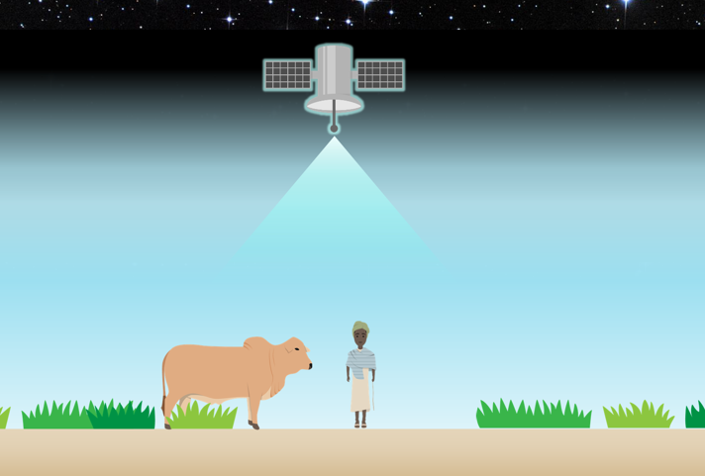
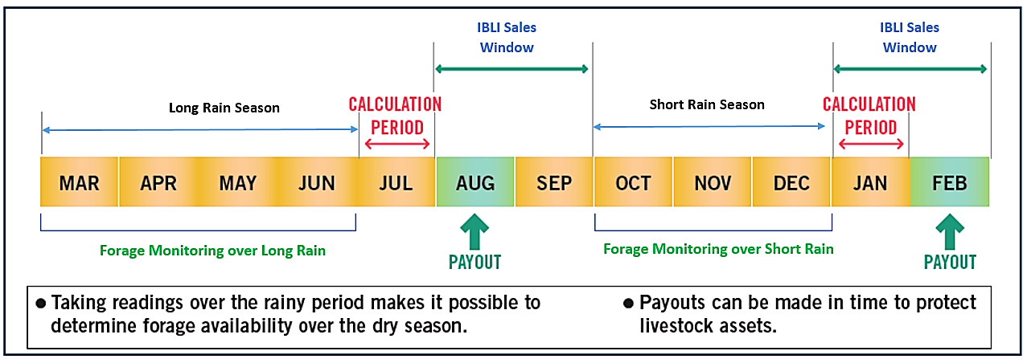
The Index Based Livestock Insurance Product
Introduced in N. Kenya in 2010 and S. Ethiopia in 2012.
Objective: To protect pastoralist herders against drought-related mortality of their livestock.
Signal: Remotely sensed normalized differenced vegetation index (NDVI) as an signal of forage availability
Index: Deviations of forage with a prescribed insurance unit, over a defined season, relative to historical average.
Privately provided with public support (WB, USAID, DfID, GoK,….)
Scaling up in Kenya under Kenya Livestock Insurance Program (KLIP), with concrete progress in Ethiopia.
Notes:
IBLI has benefited from continuous evolution and improvements of the contract based on a serious of structured assessment exercises looking into basis risk, validating its precision with on-ground quantitative and qualitative asssements.
From a predicted mortality contract to a forage scarcity contract.
From asset replacement to asset protection
Highlight the importance of mechanism to assess quality of index.

Slide 6
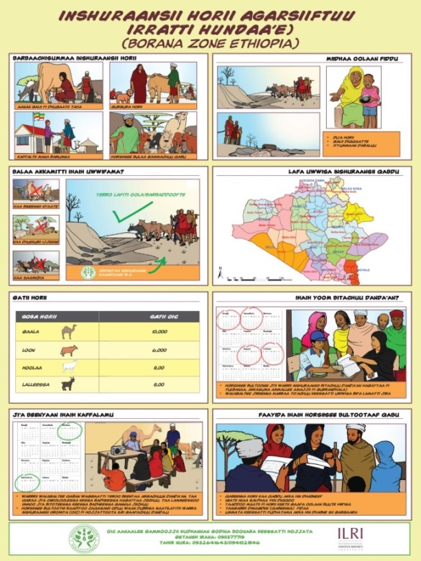
Components of a Sustainable Index-Insurance Program
Precise contract design; Satellite NDVI data. The index and its evolution. Continuous efforts for increasing precision while supporting sustainable scale.
Evidence of value and impact; Establishing household impact and value of investment.
Establishing informed effective demand; Developing client awareness and stakeholder capacity. Extension and learning support.
Low cost, efficient supply chain; Leveraging technology to increase cost-efficiency of IBLI service delivery.
Policy and institutional infrastructure: Supporting design of policy to support PPP delivery of sustainable program.
Notes:
Will only discuss the Evidence of Value and Impact,

Slide 7
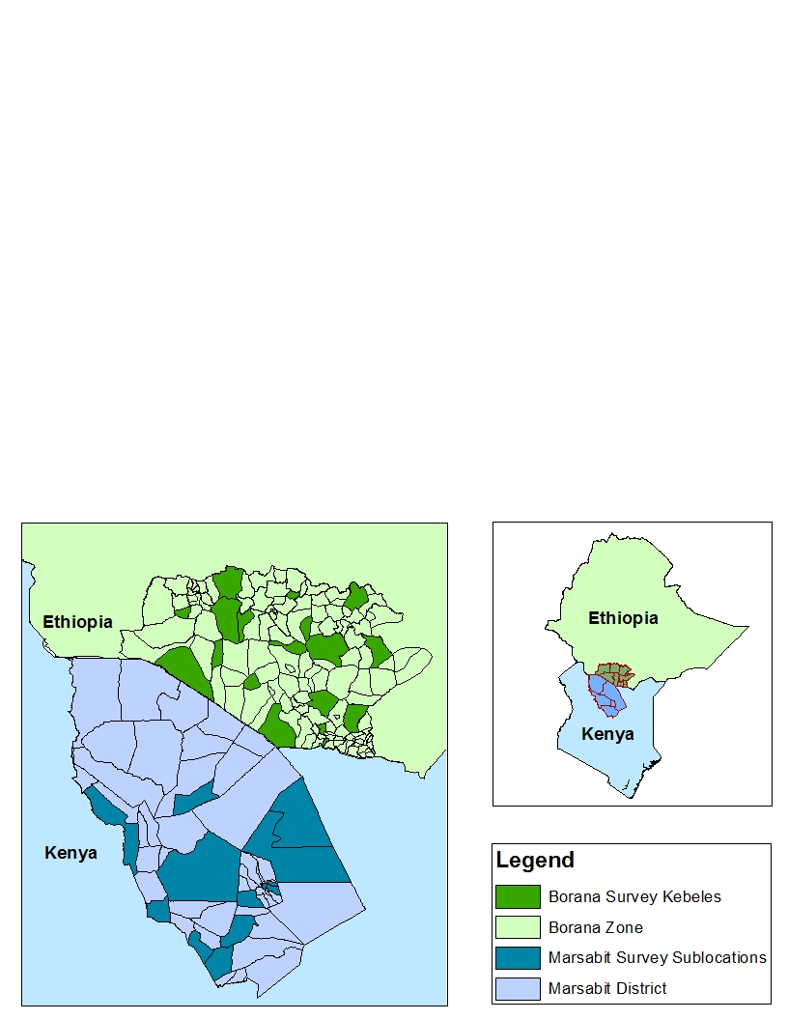
Evidence of Impact and Value
Methods:
Panel survey for impact assessment
Monitoring Evaluation and Learning surveys and interactions
Panel Survey:
Marsabit: 925 HHs over 16 locations – 6 annual rounds of data
Borana: 515 households over 17 Kebeles – 4 annual rounds of data
Research Design:
Range of encouragements (discount coupons, education games)
In Kenya, strategic overlap with HSNP (9 of the 16 locations)
  41.5% of survey hhs report purchasing IBLI at least once
  41% of the survey hhs report receiving at least one HSNP transfer
For references refer to https://ibli.ilri.org/publications/
Notes:
List of positive household impacts

Slide 8
Evidence of Impact and Value – Production, Behavioral and Welfare Impacts
  IBLI covered households:
    increase investments in maintaining livestock through procurement of veterinary and vaccination services
    experience improved production outcomes: increases milk productivity and milk income/TLU
    Reduce non-drought herd size in Kenya (reduced precautionary saving?), increase in Ethiopia (increase ROI?)
  IBLI shown to have a positive impact on improvements to mid-upper arm circumference (MUAC), a strong predictor of child malnutrition
  In Ethiopia no payment (pre November 2014). In principal insurance should be beneficial even without paying out.
    Our Ethiopia survey collects measures of subjective well-being to gauge overall life satisfaction.
    IBLI has a positive effect of HH subjective well-being, even after premium payment and w/o any indemnity payments (a “peace of mind” effect).
Terefe et al., World Bank 2017; Jensen, Barrett and Mude JDE 2017: Jensen, Ikegami and Mude The Geneva Papers 2017;
Takahashi, Barrett, and Ikegami 2018,
Notes:
In spite of the incomplete coverage IBLI provides (“basis risk”), there are strong indications that it benefits – or would benefit – most households.
* Majority of hhs better off (reductions in herd losses) by purchasing IBLI coverage than otherwise

Slide 9
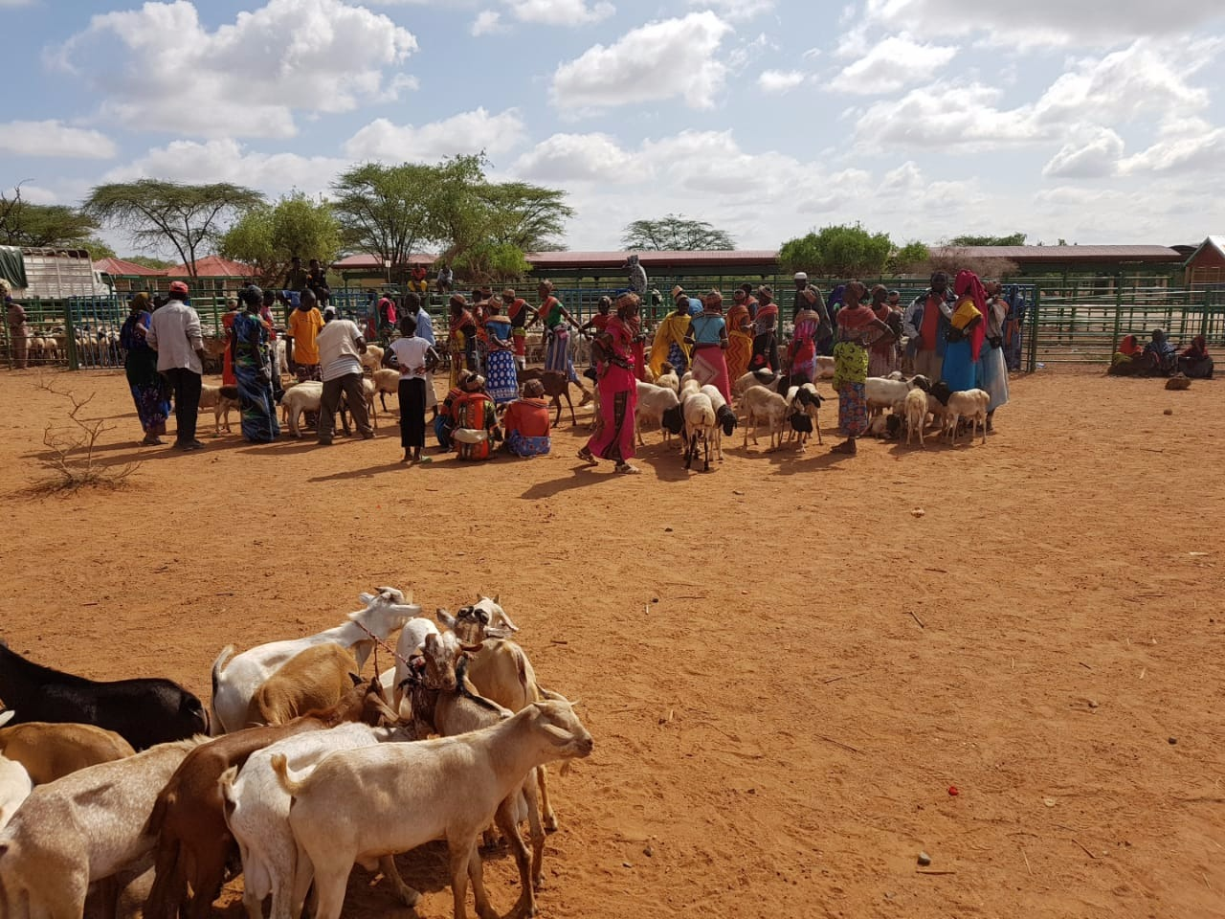
Evidence of Impact and Value – Coping Strategies
  IBLI improves post-drought coping. After catastrophic 2011 drought, IBLI covered households reported better expected behaviours/outcomes
    36% reduction in likelihood of distress livestock sales, especially (64%) among modestly better-off HHs (>8.4 TLU)
    25% reduction in likelihood of reducing meals as a coping strategy, especially (43%) among those with small or no herds
Janzen and Carter 2013 NBER

Slide 10


Evidence of Impact and Value – Social Protection
  Positive IBLI impacts do not necessary justify investing scarce development or social protection funds in IBLI.
  What is opportunity cost vis-à-vis comparative interventions (HSNP – Cash Transfer Program)?
    RESULTS:
    Both IBLI coverage and HSNP participation increase household income from milk, income per AE, and Mid-Upper Arm Circumference (MUAC) of children.
    From an average total cost, HSNP and IBLI are similar in terms of impact.
    From marginal cost perspective (more important for scaling out), IBLI considerably more cost effective than HSNP
      Note that this refers to IBLI product where client pays full risk premium plus loading of 40%
Chanterat et al. World Development, 2017; Jensen, Barrett & Mude 2017, JDE)
Notes:
In spite of the incomplete coverage IBLI provides (“basis risk”), there are strong indications that it benefits – or would benefit – most households.

Slide 11

From Demonstrated Impact to Scale
Growing body of evidence continues to highlight the socioeconomic and risk-management value of IBLI and the logic of public support.
This evidence has also played an important role in convincing the Government of Kenya to take up the scaling of IBLI under the Kenya Livestock Insurance Program
Ensuring sustainable scale will require additional investments in:
  Additional evidence on household and poverty impacts of IBLI, integration with other complementary interventions targeting poverty alleviation, risk-management and graduation to prosperity (cash transfers, graduation etc)
  Improvements in contract design and validation and alignment with other related index-based products/programs (ARC, scalable HSNP etc)
  Development of internationally recognized product quality metrics
  Enabling policy environment

Slide 12

























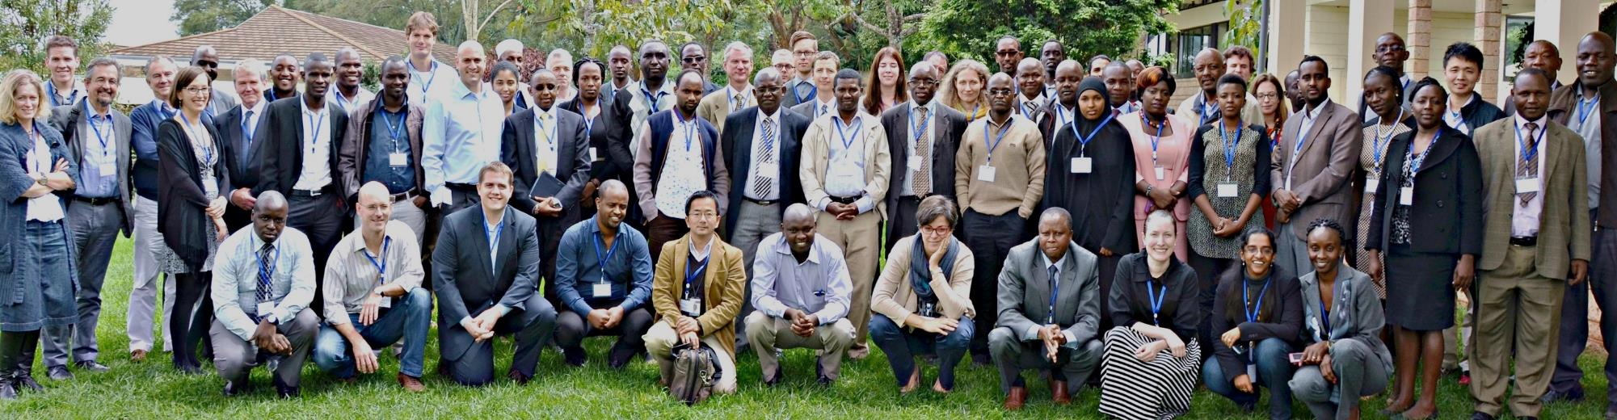
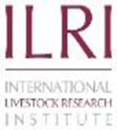

The IBLI Program is a Collaboration of Many Players

Slide 13
Thank you!
For more information on IBLI, visit https://ibli.ilri.org/

