Slide 1
BUILDING DROUGHT RESILIENCE THROUGH
“GRADUATION PROGRAMMES”
USIU-AFRICA, Nairobi Kenya
25th July 2018
Eng Jirma, H.A
Resource Mobilization and Partnership Manager, NDMA

Slide 2
Resilience-Need to be Hazard specific?
Resilience:
individual and community systems/structures at risk surviving and bouncing back from a hazard event
using capacity of an individual and the community to bounce back from any eventuality
Create possibilities to improve his or her condition towards the full enjoyment of being an empowered human being and community.

Slide 3
Building Resilience communities
Communities collectively working together to reduce their individual risk to the hazards-
E.g. participatory planning/Community based targeting for Individual/HH targeted programmes- Cash transfers
Monitoring of progress and exist/layering
Building their capacities to navigate (bounce back) from the impacts of the hazard to prevent the risk of disasters.
E.g .investment in community systems- strategic boreholes, building flood control dykes/structures
E.g Policy changes influencing on eco-system services use- water resource sharing that could impact on livelihood productions

Slide 4
Graduation=Measurement and/or layering?
Or both? : we have to determine/
Starting point information (baseline information)
Present state (real time information)
complementary/supplementary
Of what?
Individuals /Households-Foundations of safety*
Livelihood health
Ecosystems services
Community systems/structures
Enabling Policy environment
Food for thought:
So which programme is our focus out of the 5 to incorporate graduation ?
Can one programme stand alone without the other? Multifaceted? Layering?
Is it fair to measure graduation of one without the other?
*During normal days, an individual enjoys basic rights such as immunization, food, water, clothing and shelter as their foundation of safety

Slide 5
Individuals /Households : Foundations of Safety HSNP Programme
Regular cash transfer- Kshs 5400 every 2 months Targeting 100,000HH for 4 counties(Marsabit, Isiolo, Turkana, Wajir)-Poverty as criteria
Scalable cash transfer to additional HH in the same counties based on objective drought triggers -Ksh 2700/month- Trigger lasts for >=1month
Are there other cash transfers targeting the same HH??? Based on other target criteria's?( Layering, multifaceted) –KLIP/VCT/PLWD/OPCT/ Food vouchers/water vouchers/social inclusion-Health/Cash for asset-

Slide 6
SUCCESS/LESSONS LEARNT
Graduation/layering led to :
Effectiveness/efficiency
Collaboration/Single registry/Coordination/ Data sharing protocols/
Linkages to IPRS/ improve targeting
Upgrade of supportive infrastructure, technology key
private sector involvement key/ Triggered improved financial services
Knew knowledge generated
systems enhanced
Improvement in beneficiary status and situation measureable-Planning graduation/exit to other programmes
Social accountability systems integrated in programmes/led by Gok
Evidence based policy successfully influenced
Policy on Layered/Graduated risk financing instruments developed under DRFS, fast tracked some delayed policy decisions

Slide 7
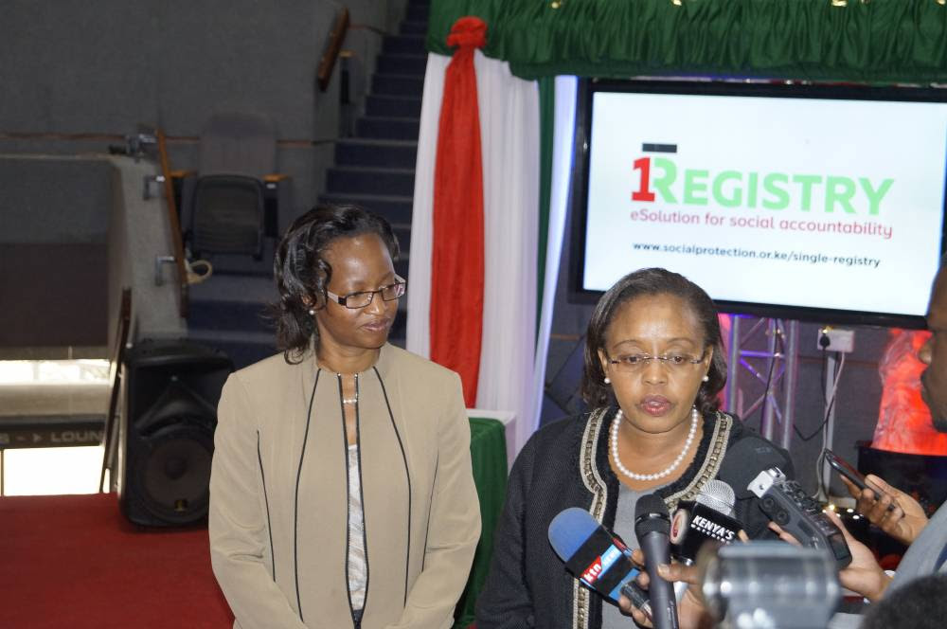

Slide 9
VCI June 2017

Slide 11
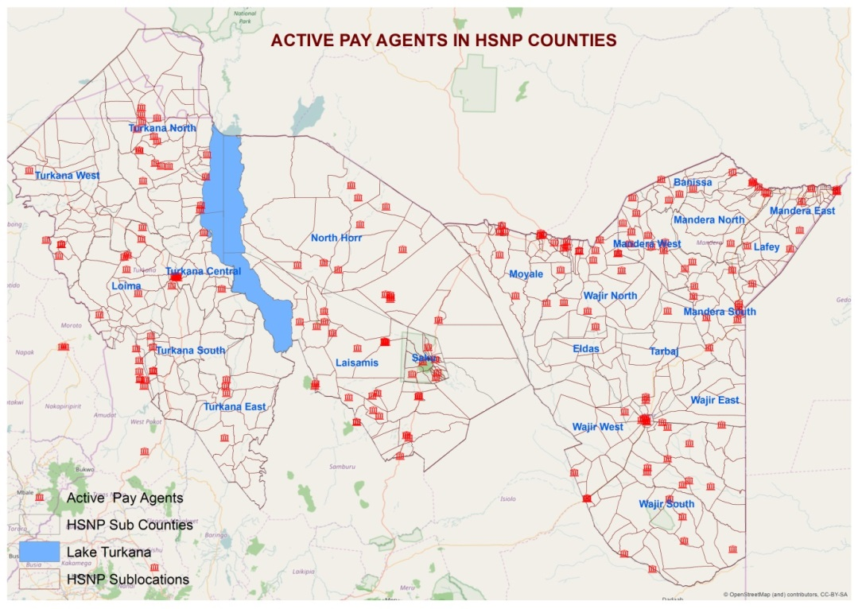

Slide 12
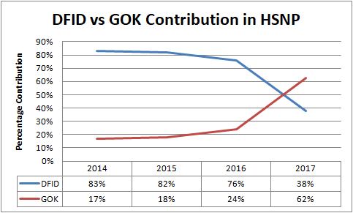

Slide 13
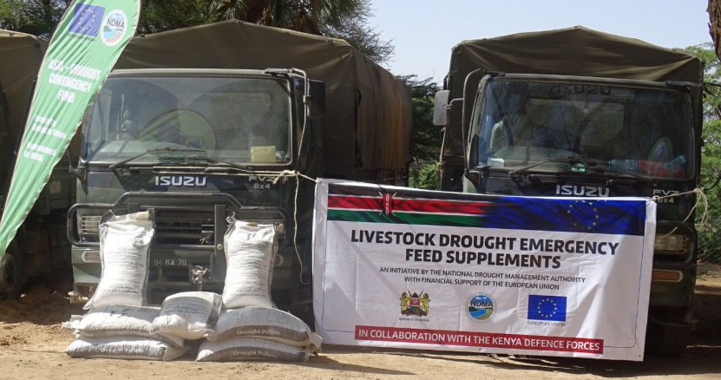

Slide 14
THANK YOU

